Slide 1

DX University
Bryce Canyon, UT – 2012

Slide 2
How to Build a Dxing Station
– Antennas –
Milt Jensen N5IA

Slide 3
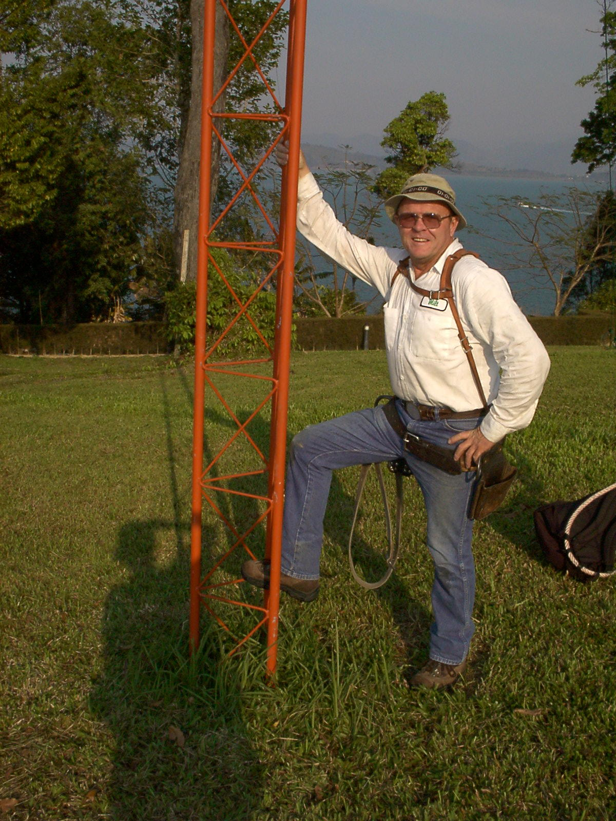
Milt Jensen, N5IA
First licensed as a Novice in 1960, with the callsign KN5FPO.
Education in Electronics at the El Paso (Texas) School of Electronics and have held an FCC commercial license since 1961
Manager of Development and Deployment for a Broadband Wireless ISP.
Specializes in VHF/UHF repeater design/deployment.
Top band contester with many QRP wins to his credit.

Slide 4
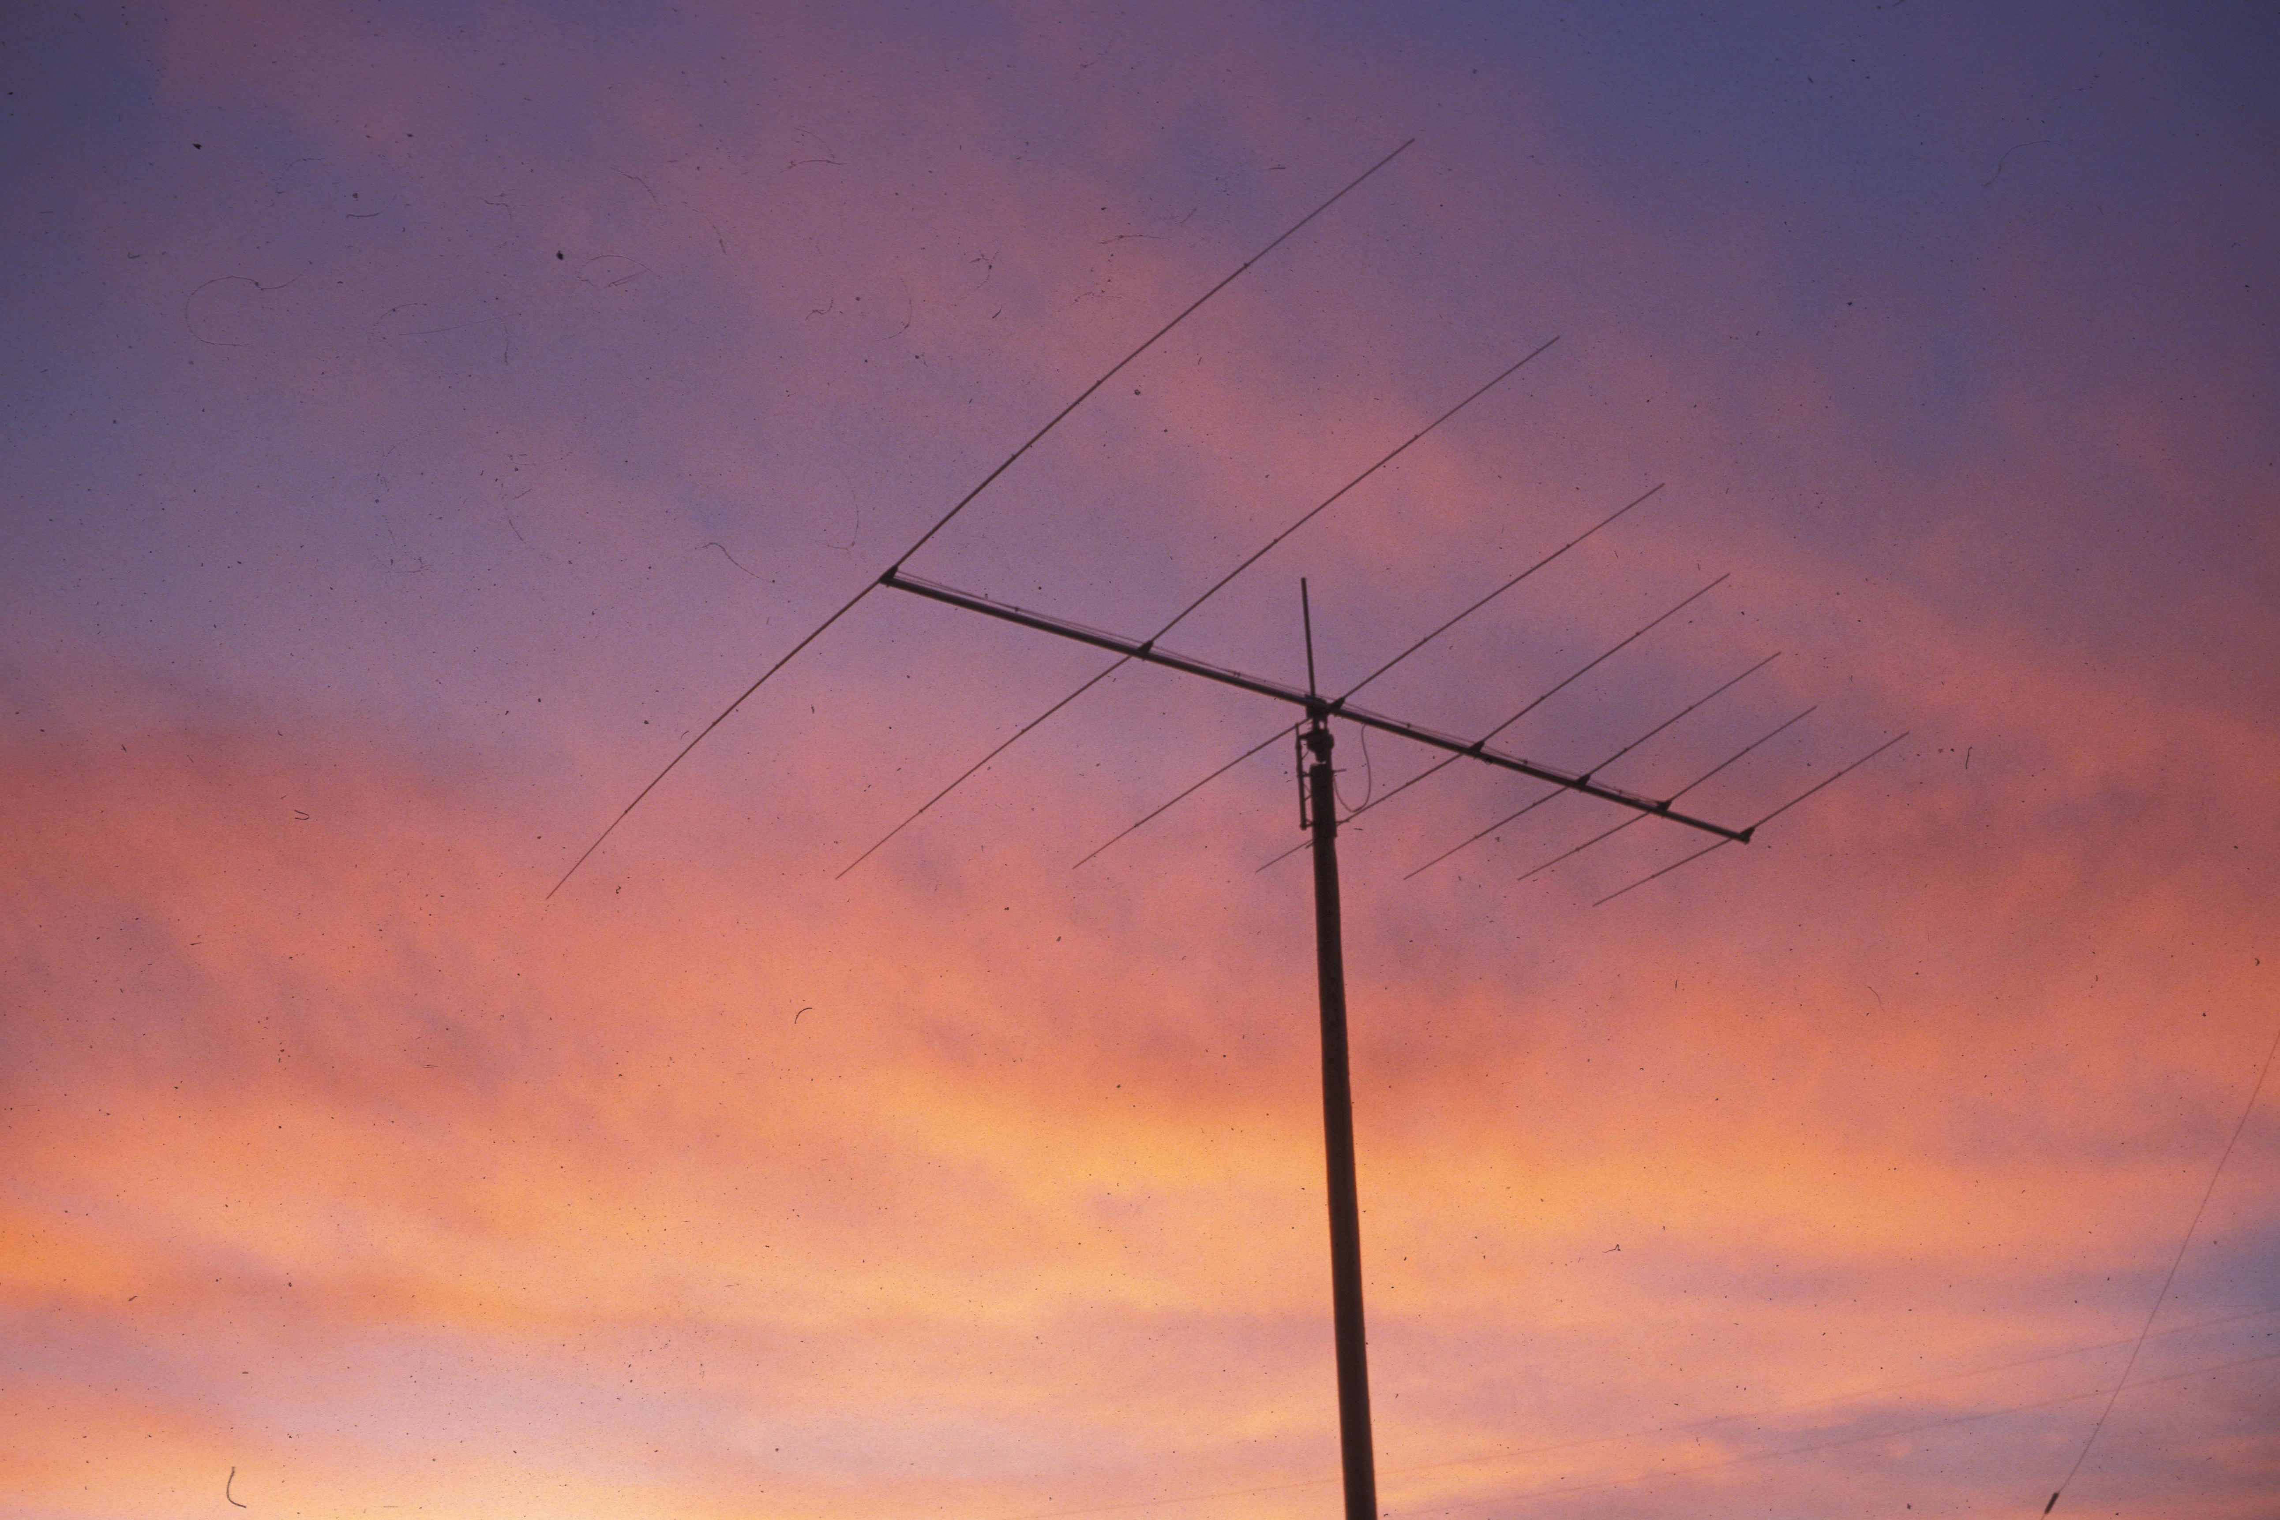
1981 Log Periodic

Slide 5
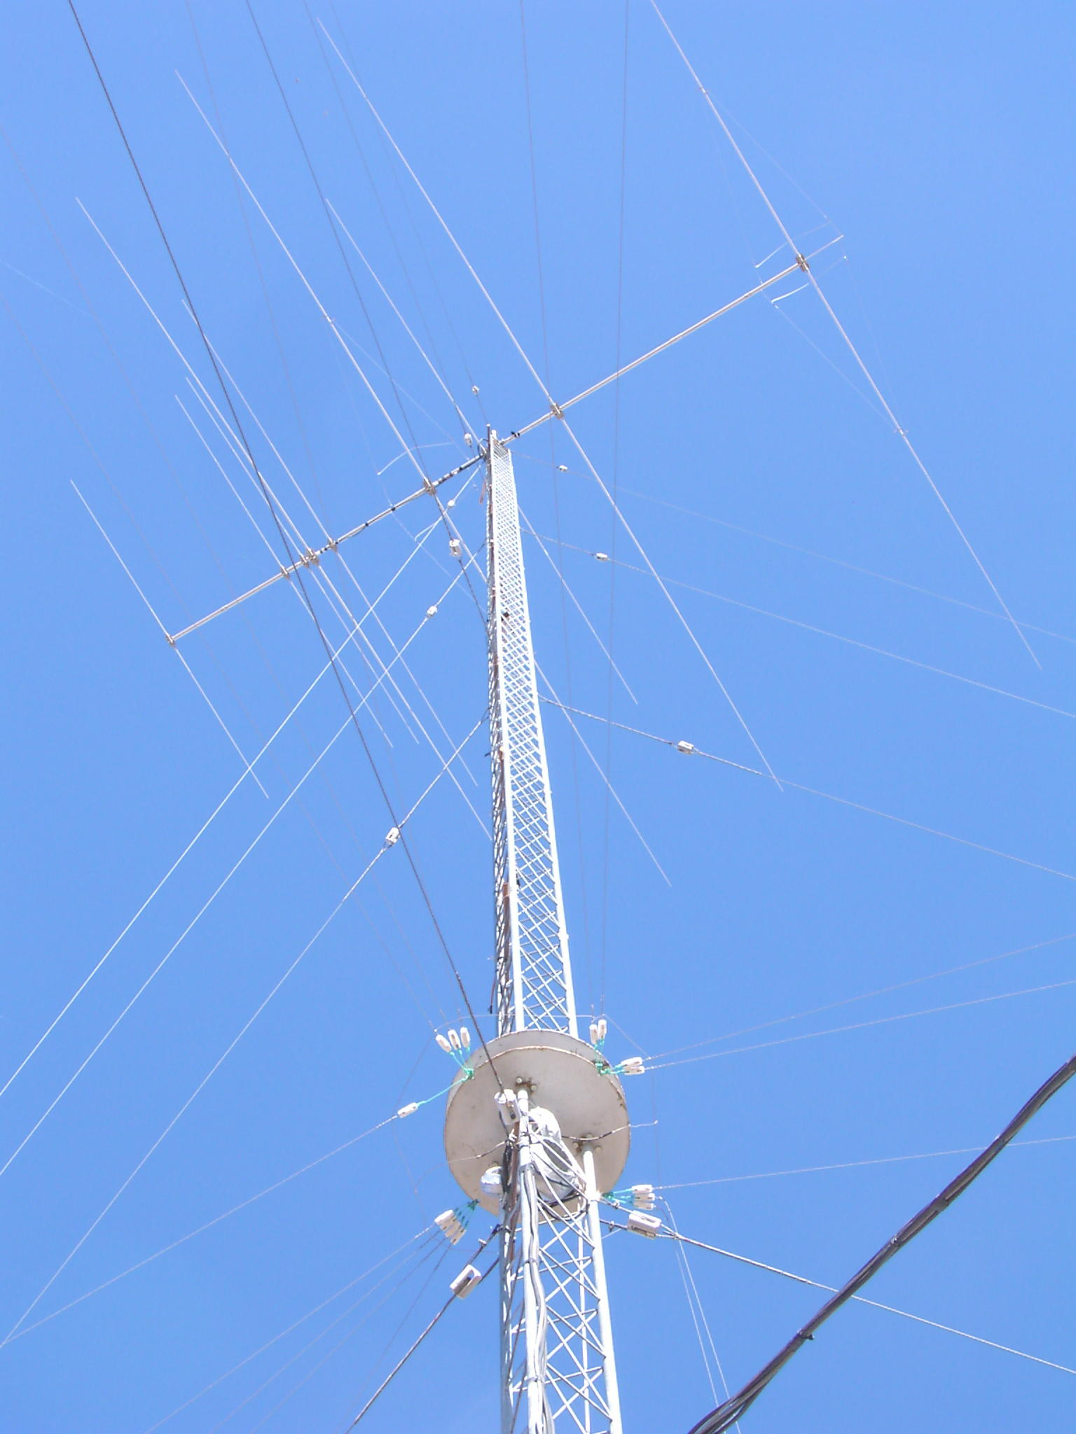
N5BG “All in One Tower”

Slide 6
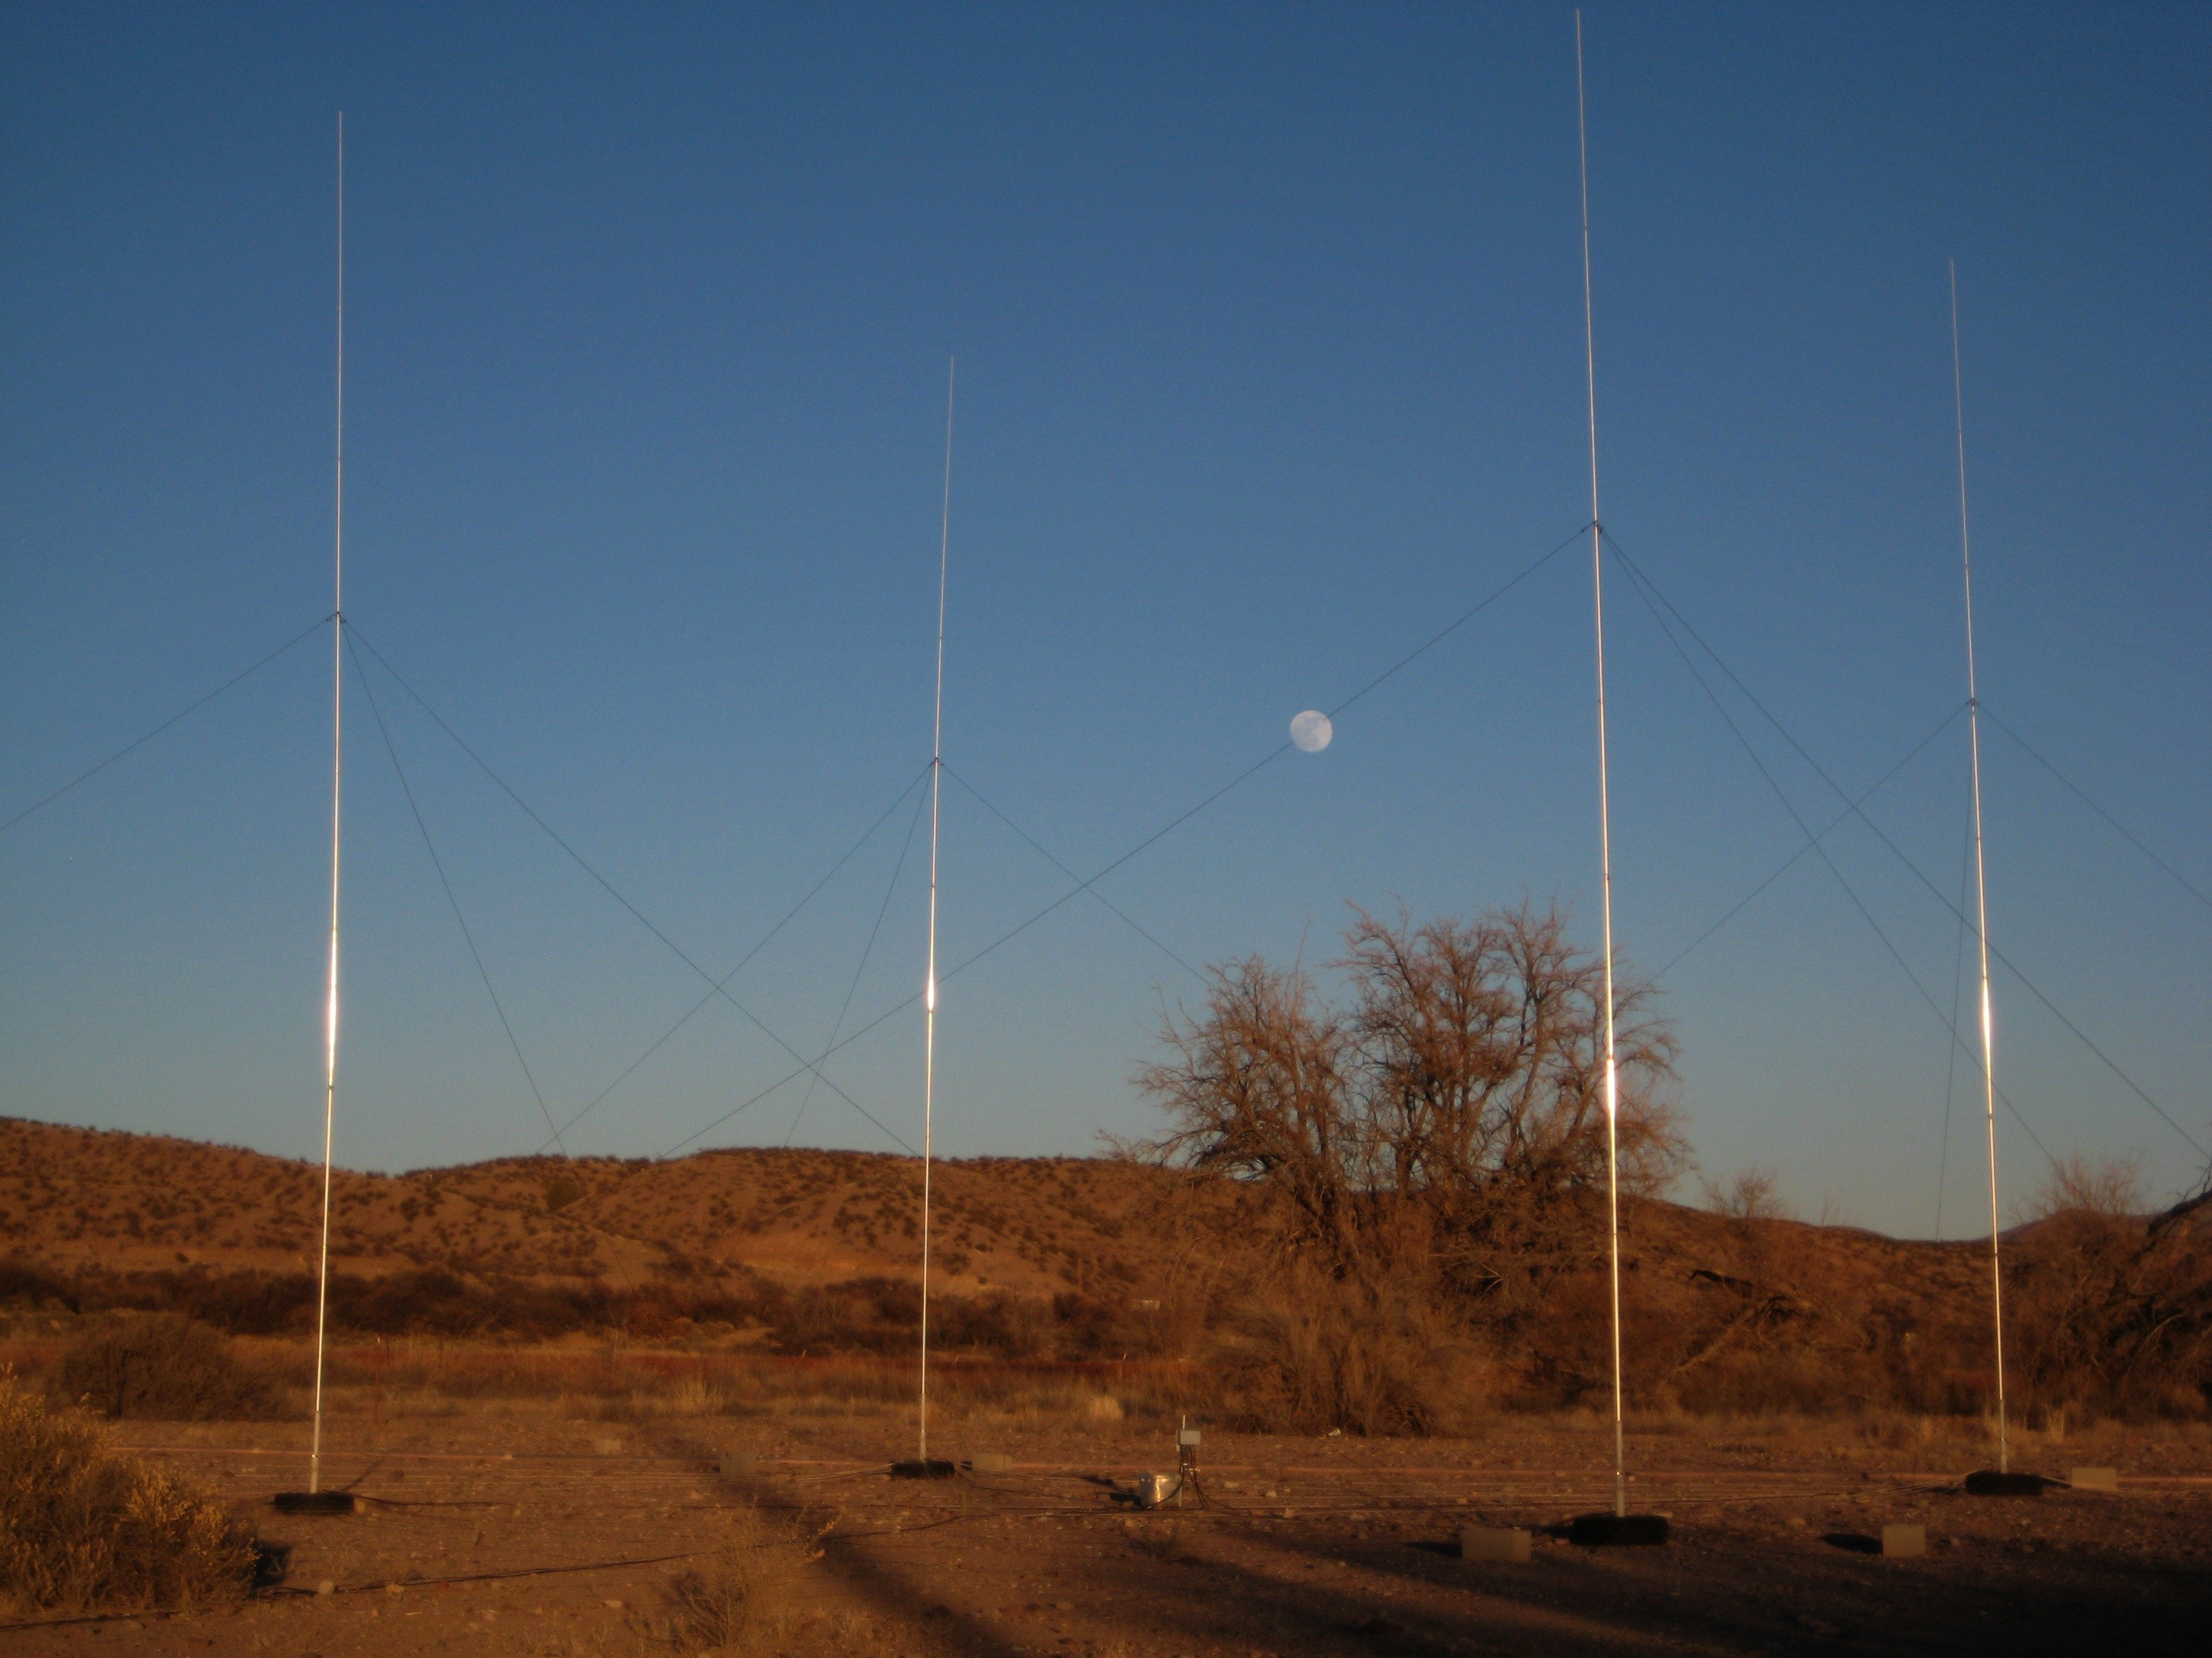
N5BG 40 Meter 4-square

Slide 7
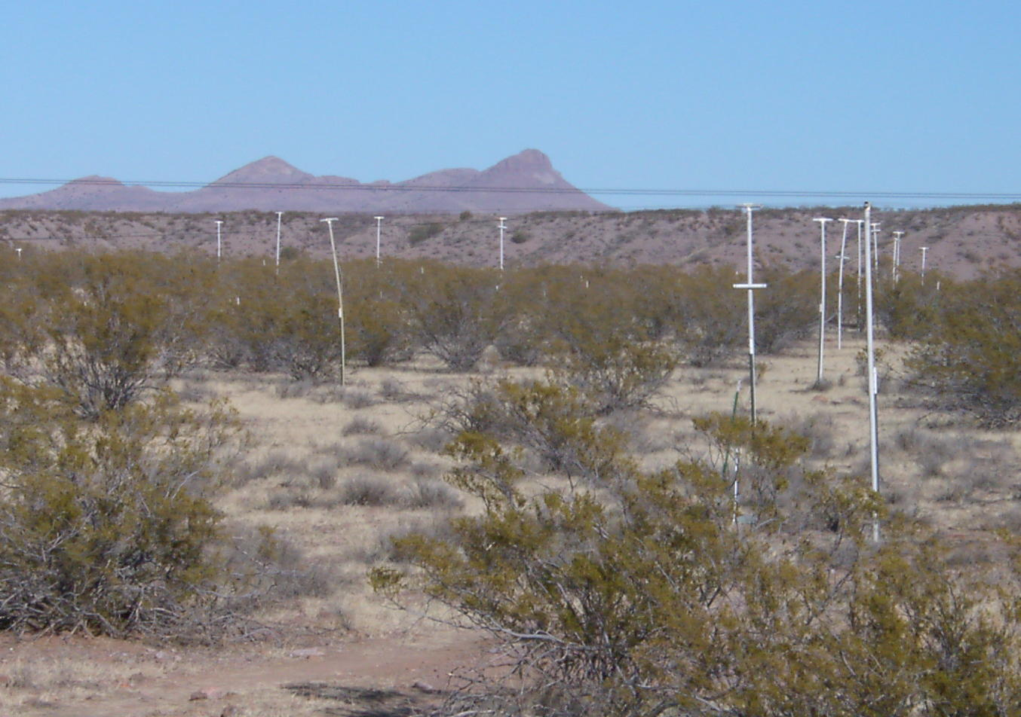
Beverages

Slide 8
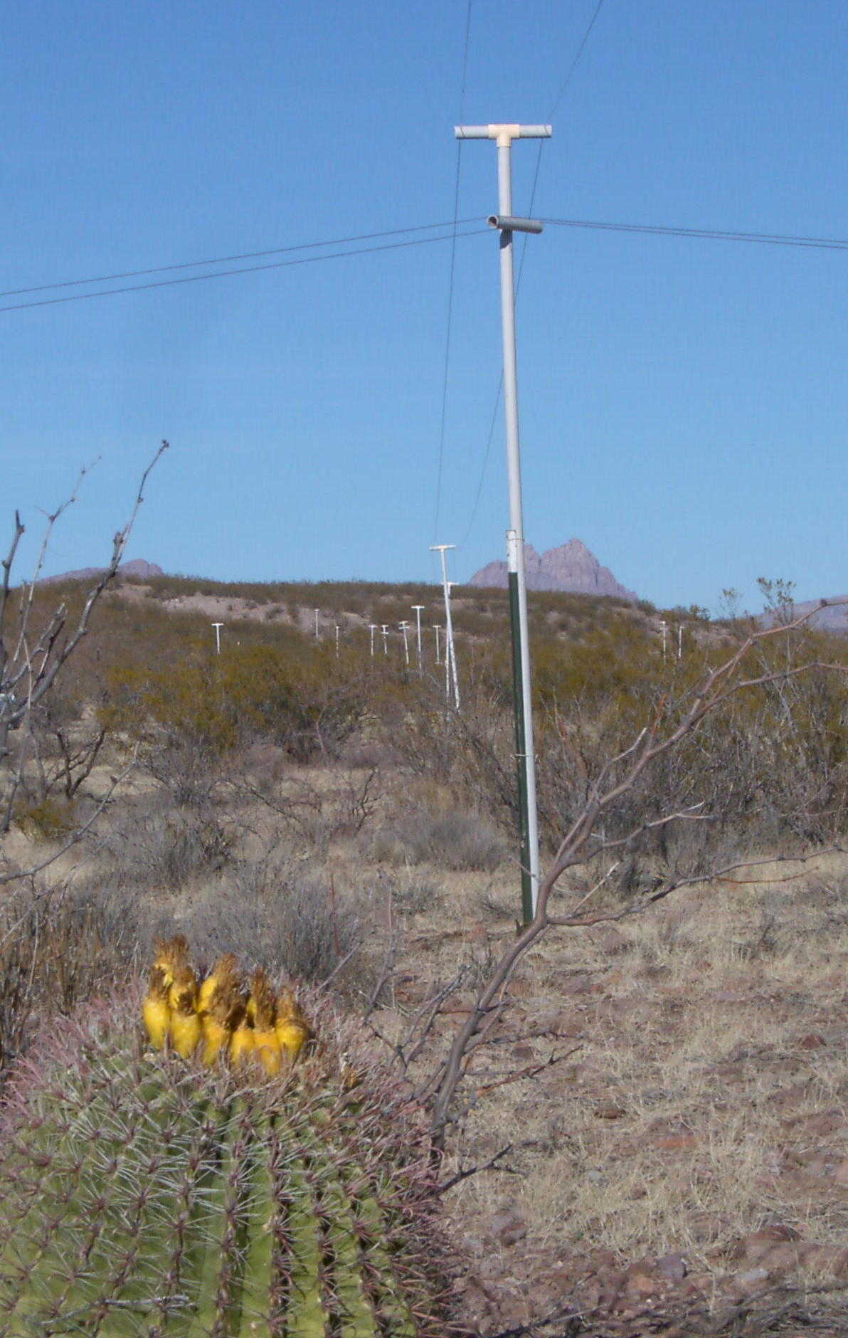
Beverages

Slide 9
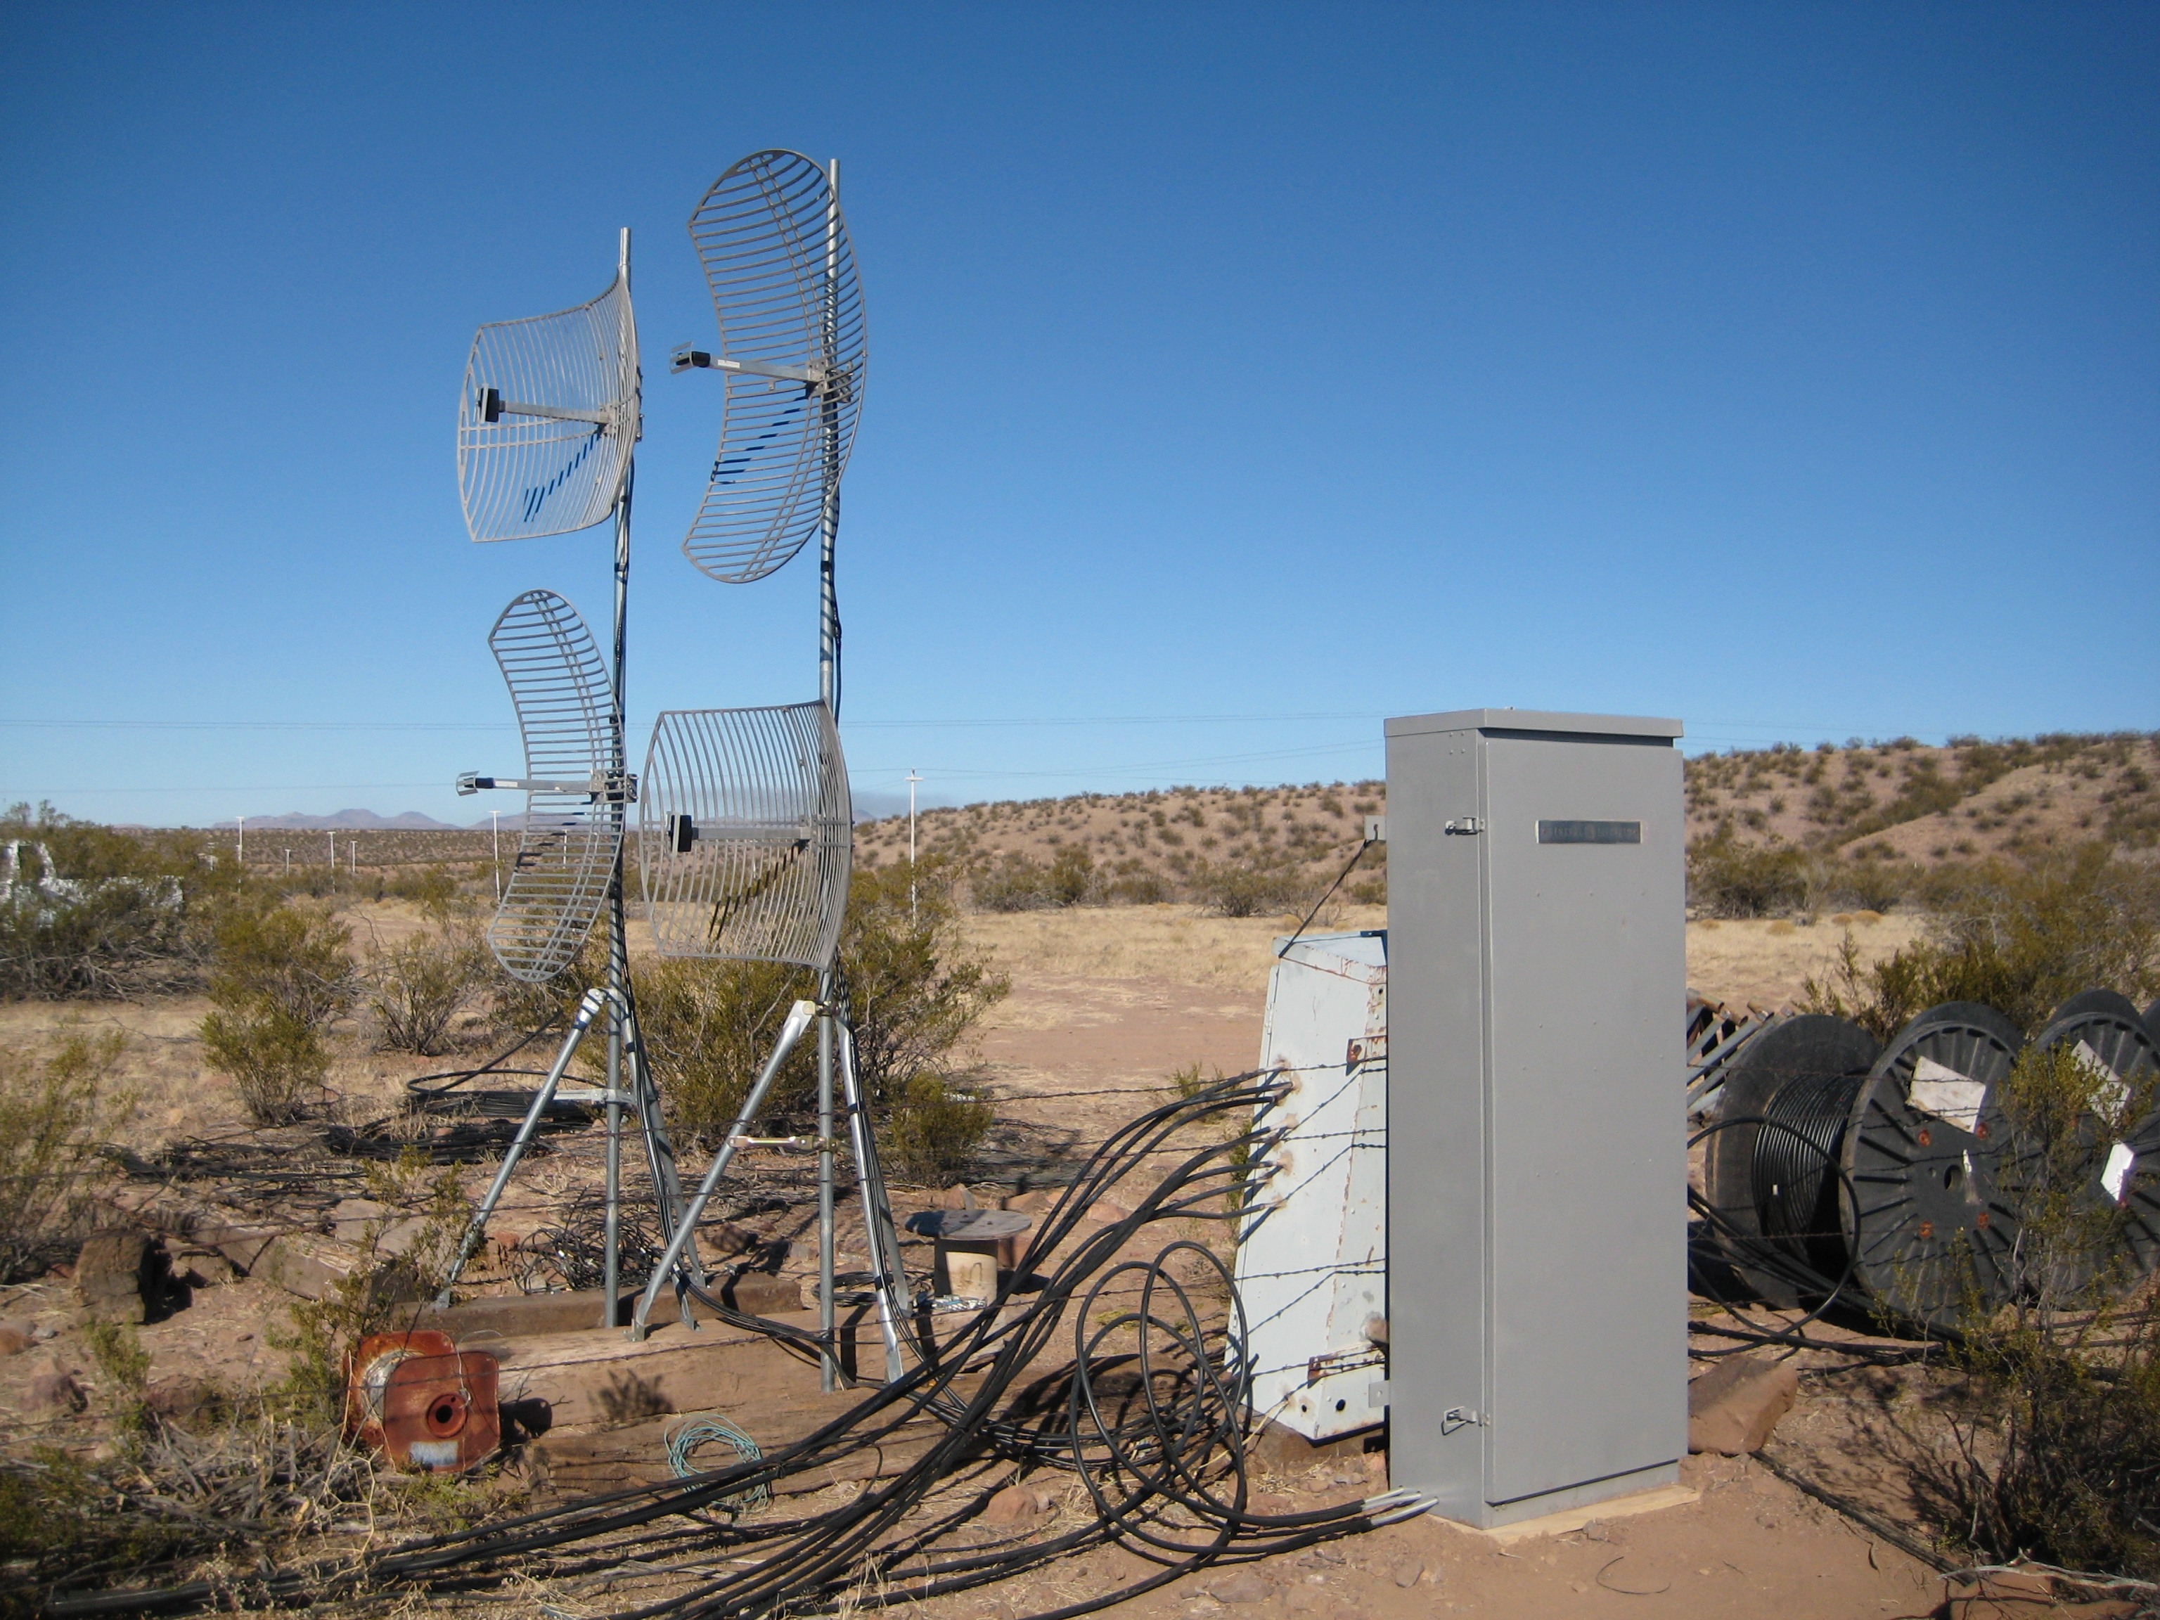
Beverage collection point

Slide 10
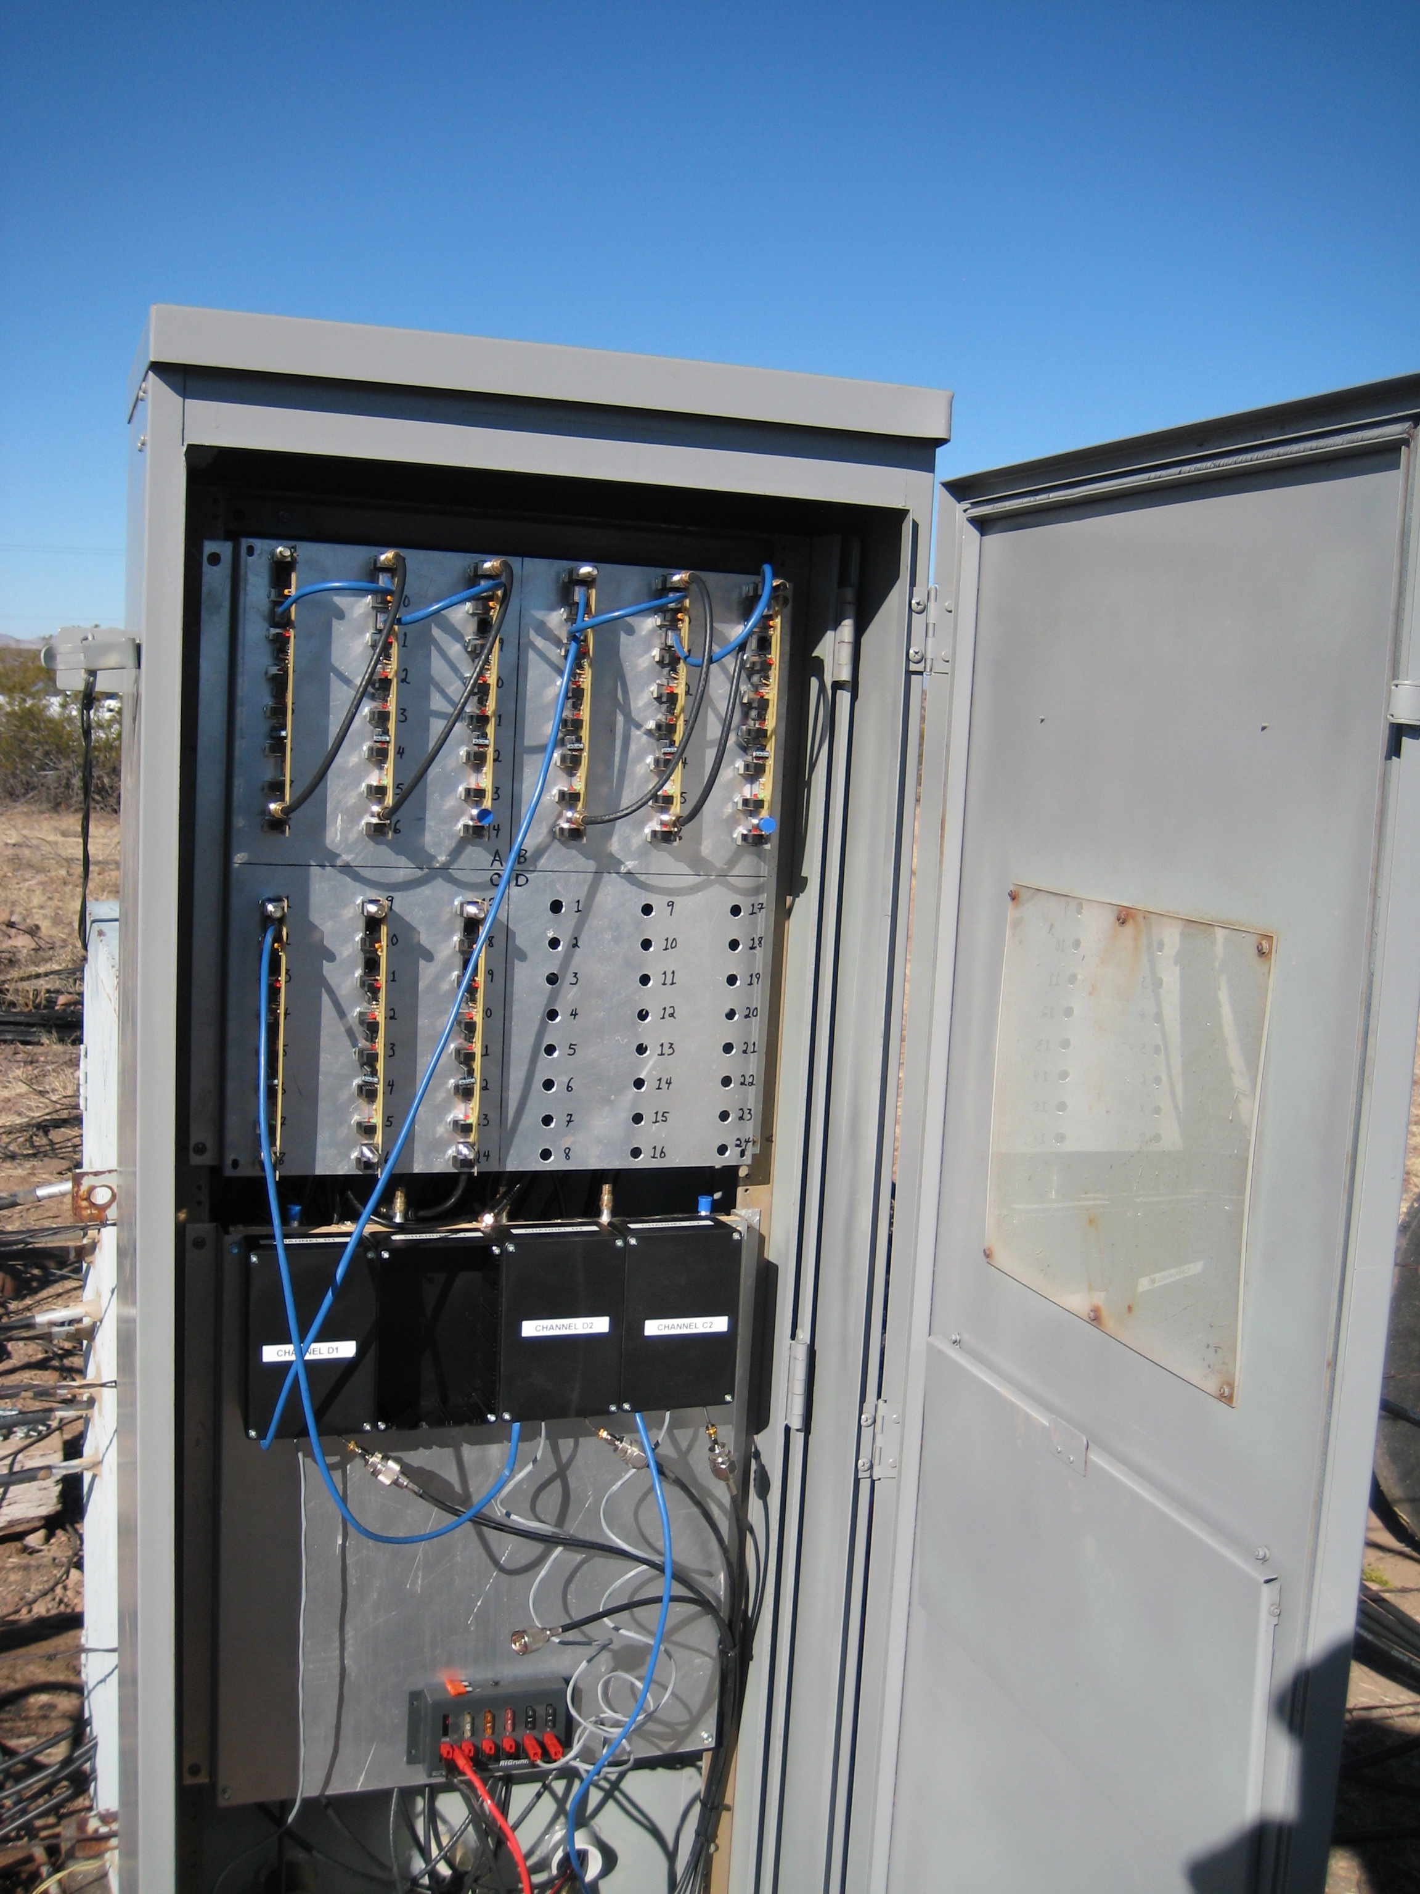
Beverage switching front panel view

Slide 11
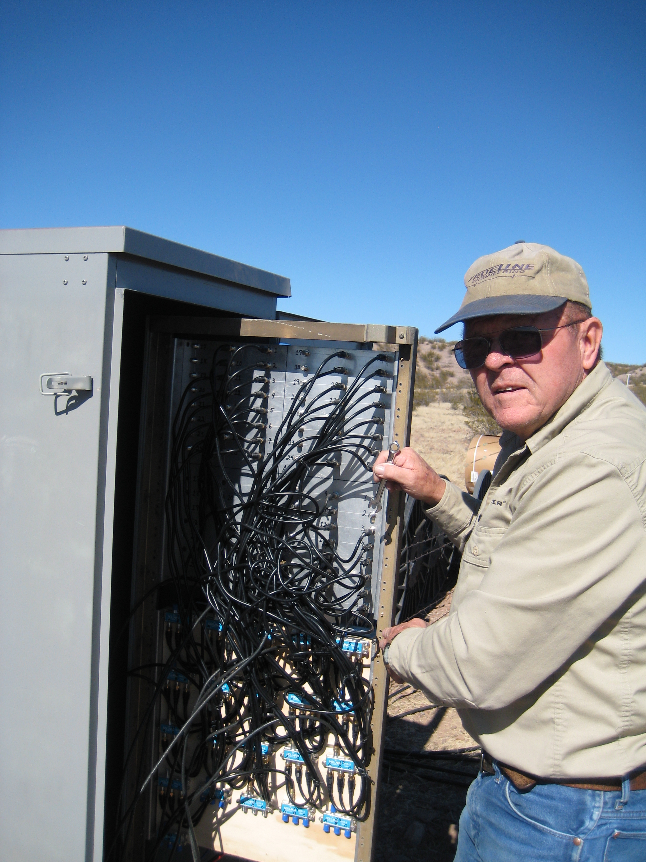
Beverage cabling

Slide 12
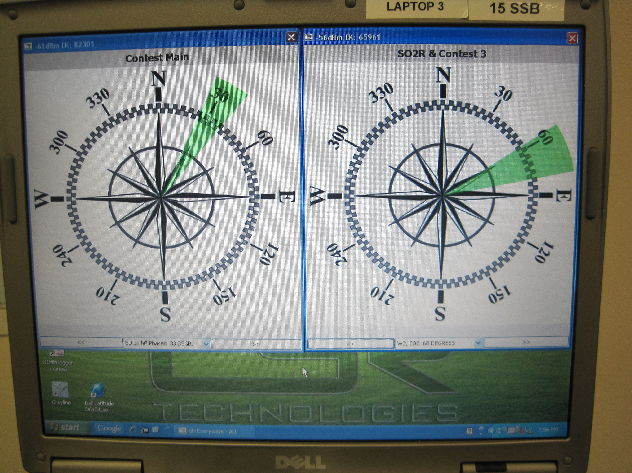
Diversity RX Beverage Selection remote control screen display at N5BG.

Slide 13
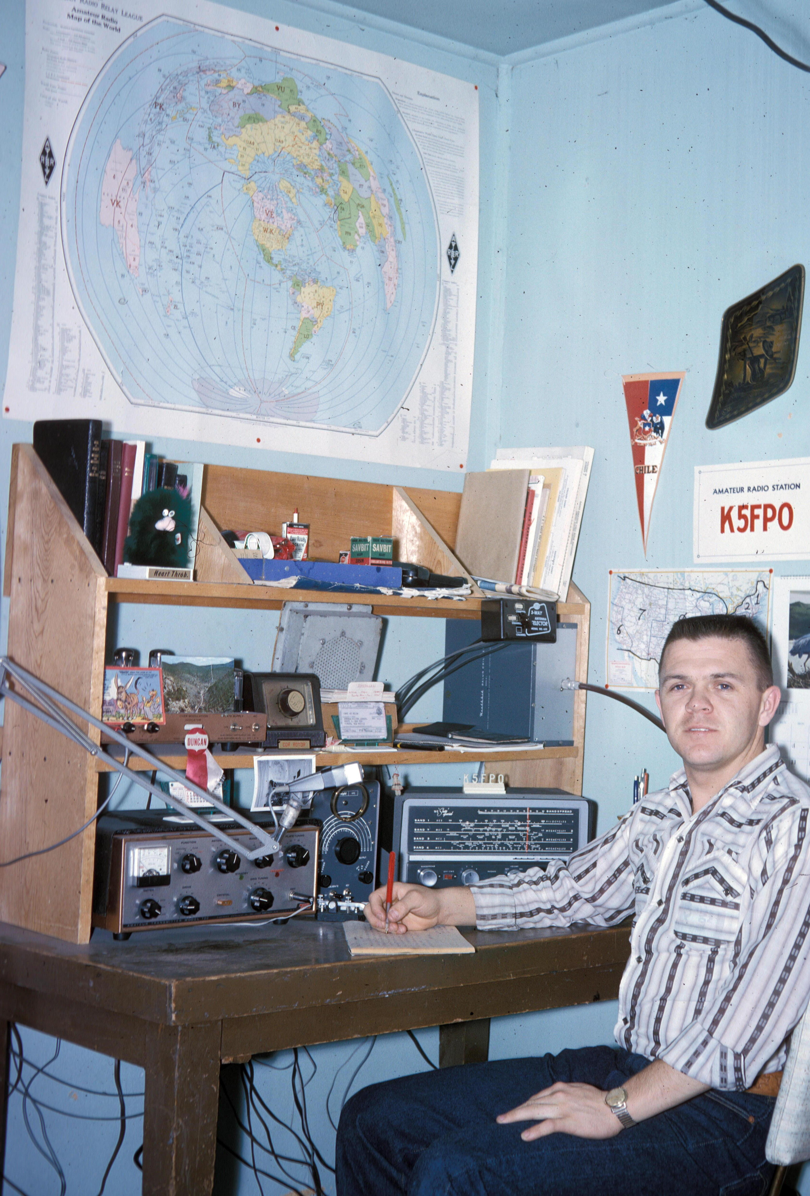
KF5PO 1964

Slide 14
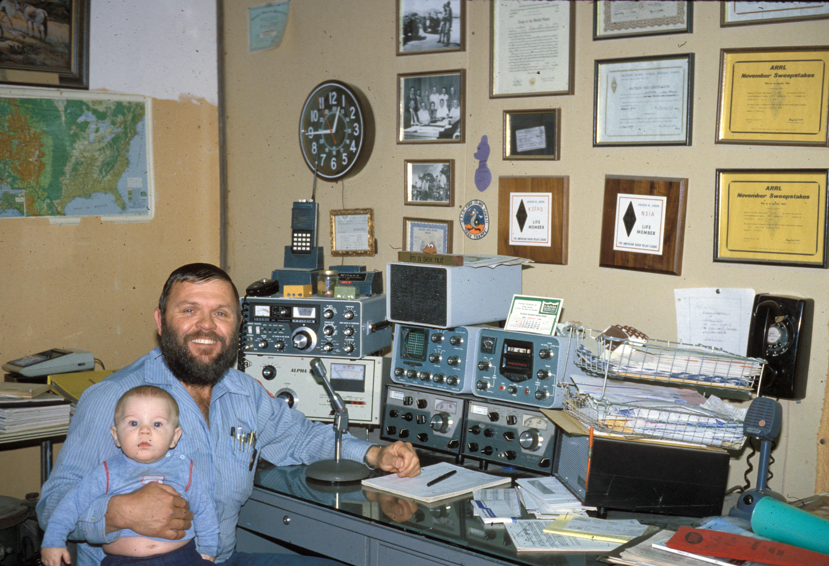
N5IA 1981

Slide 15
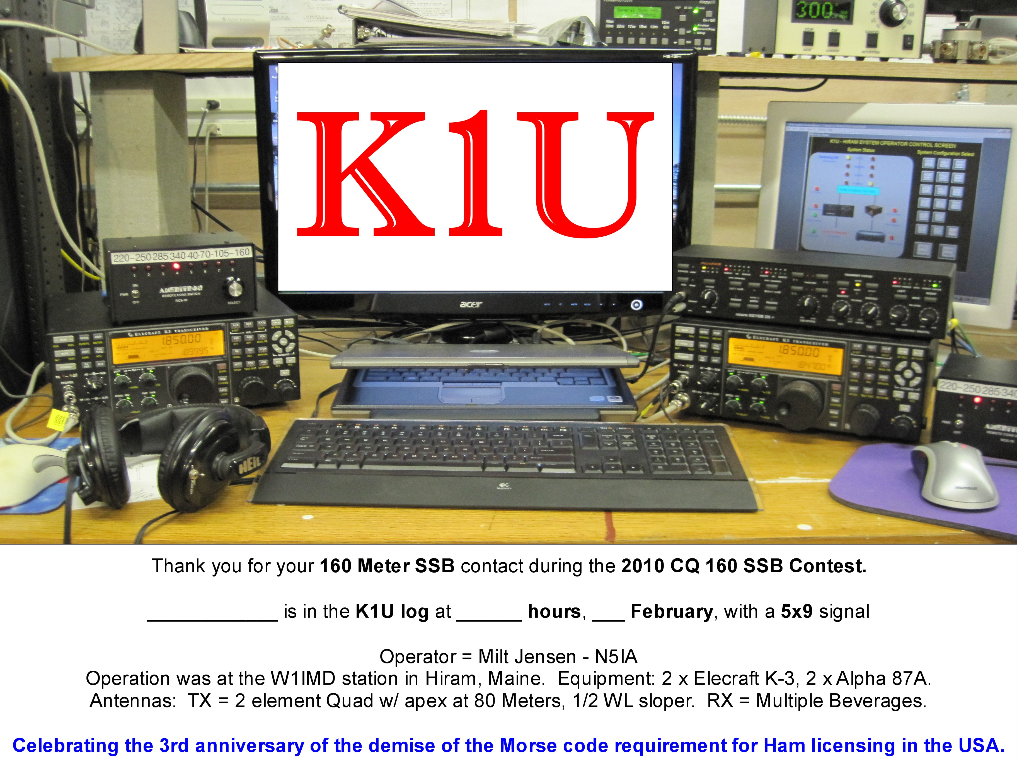
K1U at W1IMD 2010

